Slide 1
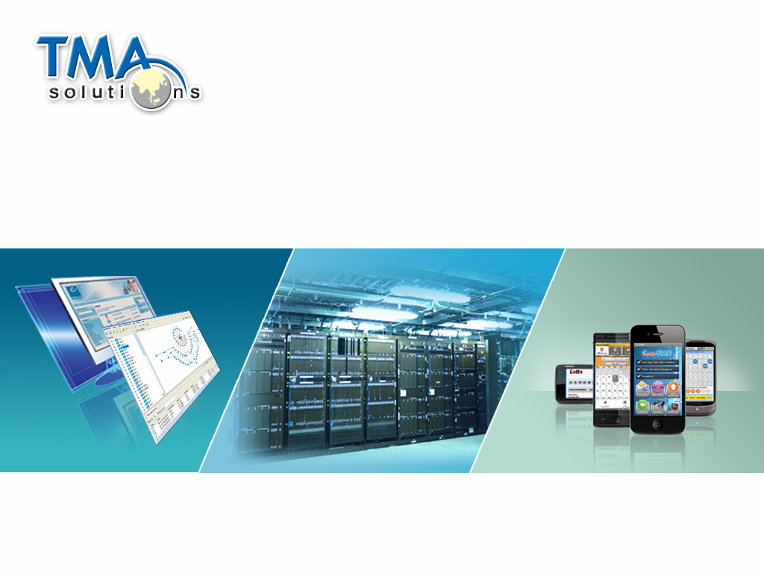




OMA Lightweight M2M

Slide 2
AppIoT Content

Slide 3
Thank You !

